Slide 1
All About Data Retention
Tactics for Optimizing Computing Resources
Edward Pollack
Microsoft Data Platform MVP

Slide 2





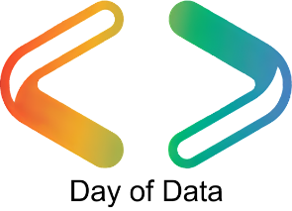

Ed Pollack
Microsoft Data Platform MVP
Published author of:
Dynamic SQL: Applications, Performance, and Security, 2nd Edition
Analytics Optimization with Columnstore Indexes in SQL Server
2nd edition forthcoming
Expert Performance Indexing in SQL Server, 4th Edition
Published in Expert T-SQL Functions in SQL Server, 3rd Edition
Author on Simple Talk.
Organizes:
Day of Data Albany
SQL Saturday New York City
Capital Area SQL Server User Group
Speaker at many data events

Slide 3
Agenda
The data life cycle
Data Retention: What is it?
Benefits of Retention
Retention strategies
Selling retention to managers/VPs/Execs
Conclusion & Questions (?)

Slide 4
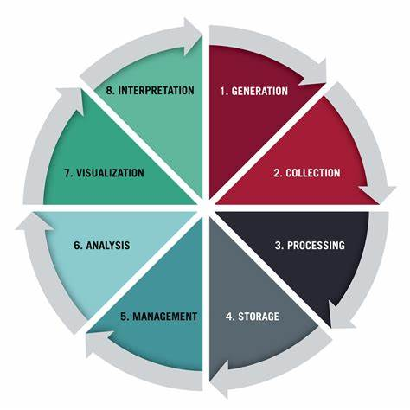
The Data Life Cycle

Slide 5
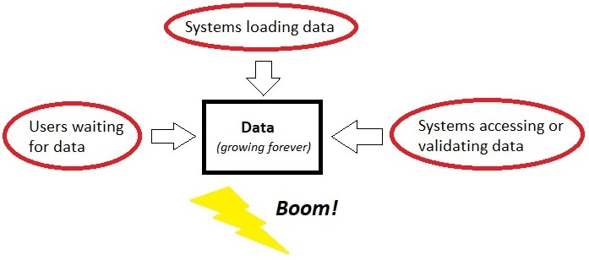
What Can Happen?

Slide 6
Create a Retention Period
Is there ANY chance that data will grow large?
Define a data lifecycle for it.
Define retention periods for its data lifecycle.
This is a business decision first, technical decision second.
This does not have to be time-consuming!!!

Slide 7
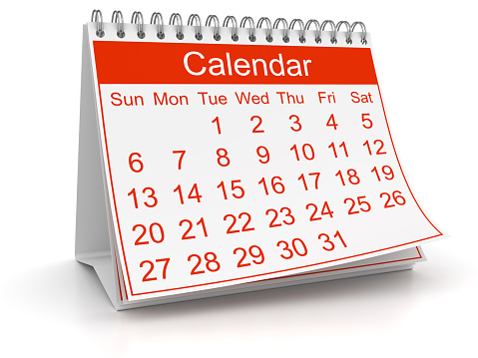
Common Retention Periods
Temporary Data (12 hours, 1 day, etc…)
Short-Term Data (5 days, 2 weeks, etc…)
Mid-Term Data (1 month, 6 months, 1 year)
Long-Term Data (3 years, 5 years, 7 years)
Forever Data (All of eternity)

Slide 8
RPO/RTO/Availability
Data Retention is directly linked to these:
RPO: Recovery Point Objective
Acceptable data-loss in an emergency.
RTO: Recovery Time Objective
Recovery time in an emergency.
Availability: Uptime for data access.

Slide 9
RPO/RTO/Availability
All things being equal:
Larger data has a longer RTO.
Larger data has a longer RPO.
Larger data takes longer to recover from an emergency.
Spend more money or time to improve this…
…or manage data size!

Slide 10
Special Types of Data
Internal vs. external
Log data
Temporary data
Transient data
Posterity data (aka: “Just in case” data)

Slide 11
Transactional vs. Analytic
Each can/should be stored differently
Transactional
Frequent Inserts/Updates/Deletes
More columns/less rows
Very time-sensitive
Analytic
Controlled data load processes
More rows/less columns
Often flexible

Slide 12
Privacy/Compliance
Are you required to retain data for a period of time?
Are you required to delete data after a time period?
What do customer contracts say?
These can be changed!
What do compliance laws require?
Examples: GDPR, HIPAA, COPPA, etc…
These are out of your control
End-user license/data agreements?

Slide 13
Retention Strategies
MANY ways to apply retention to data.
Strategies can easily be combined.
Align retention strategies with:
Business needs
Cost
Performance
Compliance

Slide 14
Retention Strategy: Delete Data
Simplest form of retention.
If older data is not needed, simply delete it!
Remember to index the filter column, if needed.
DELETE TOP (1000) OrderChangeLog
FROM dbo.OrderChangeLog
WHERE OrderChangeLog.ModifiedDateTime <=
DATEADD(MONTH, -12, GETUTCDATE());
WHILE @@ROWCOUNT > 0
BEGIN
DELETE TOP (1000) OrderChangeLog
FROM dbo.OrderChangeLog
WHERE OrderChangeLog.ModifiedDateTime <=
DATEADD(MONTH, -12, GETUTCDATE());
END;

Slide 15
Retention Strategy: Archive Data
Data is not needed by an application, but must be retained for other purposes or posterity.
Create a new location for it and move it.
Can be in the same database/server or different.
May treat as analytic data once archived.
Can often be (heavily) compressed.
This is a good alternative to data deletion when people are nervous about permanently deleting data!

Slide 16
Retention Strategy: Remove Some Data
Some larger columns are not needed after a retention period.
Notes, description, error log details, etc…
Those big string/binary columns
Can NULL/blank/drop freely.
If archiving, then the target can omit unneeded data elements entirely.

Slide 17
Retention Strategy: Compression
Older/less used data can often be compressed.
Analytic data should be compressed
ROW/PAGE/columnstore compression (for SQL data)
Parquet/Delta Lake (Files in Fabric, Synapse, etc…)
File compression (for uncompressed file data)

Slide 18
Retention Strategy: Partitioning
Physically/logically split up a table into separate files.
Each part may be compressed differently (or not).
Partition truncation/split/merge can be used.
Partition elimination can improve performance.
Automate partition management processes.

Slide 19
Retention Strategy: New vs Old Data
For tables with lots of history
Separate data structure into 2 separate ones:
The new, write-heavy data (smaller data)
The old, read-only data (bigger data)
Can optimize each separately based on usage:
Compression
Indexing
Constraints
Rowstore/memory-optimized for write-heavy?
Columnstore for read-heavy?

Slide 20
Retention Strategy: Turn OLTP into OLAP
Old data not used by an app anymore?
Rarely/never written to?
Adjust to analytic data storage/conventions.
Columnstore indexes
Heavy compression
Data lake
Data warehouse
Dedicated analytics engine?

Slide 21
Retention Strategy: Other
3rd party applications
Hardware solutions
Data Deduplication
Hosted data management platforms
Other?

Slide 22
Notes on Timing
Retention is (usually) data manipulation
Deletion
Updates
Data movement
Compression
Partition magic (can be DDL-only)
Treat retention as maintenance
Perform off-hours, or when tolerable
Avoid conflicts with other processes

Slide 23
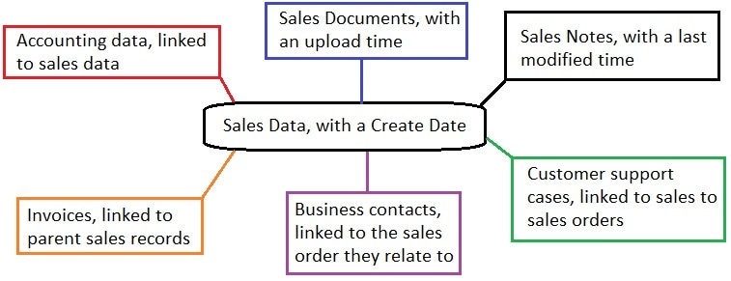
Relational Data Retention
When data has related data, consider carefully what a retention period entails:

Slide 24
Conclusion
Retention is a key part of database design/architecture!
Effective retention can:
Improve performance
Reduce data footprint
Improve compliance
Improve organizational communication
Save money!
Creating/owning retention policies is a leadership/collaboration opportunity!

Slide 25
Thank You!
Find me here:
ed@edwardpollack.com
Ed Pollack | LinkedIn
Find my content here:
EdwardPollack (Ed Pollack) (github.com)
Edward Pollack, Author at Simple Talk (red-gate.com)
Ed Pollack, Author at SQL Shack - articles about database auditing, server performance, data recovery, and more

